Slide 1

School of Electronics and
Communication Engineering
Team No: 03
Title: Wireless Alerting System
Team Details
Sl.No. | Roll No. | Div | SRN | Name
1 | 402 | D | 01FE21BEC356 | Manjunath Inamati
2 | 405 | D | 01FE21BEC177 | Goutami Naragund
3 | 352 | C | 01FE21BEC163 | Chetan Paranatti
Guide Details :
Saroja V Siddamal
Minor Project - 2024

Slide 2
School of Electronics and
Communication Engineering
Contents :
Introduction.
Motivation.
Literature survey.
Problem statement.
Hardware details.
Methodology.
Results and implementation.
Conclusion.
References.
Minor Project - 2024

Slide 3
School of Electronics and
Communication Engineering
Introduction:
In today’s fast-paced industrial environment, timely alerts are crucial for ensuring safety, maintaining operational efficiency, and preventing costly downtimes. Traditional wired alerting systems, while reliable, can be cumbersome and expensive to install and maintain. Wireless alerting systems offer a flexible and cost-effective alternative, providing ease of installation and scalability. With advances in wireless technology, it is now possible to develop robust alerting systems that can operate efficiently in various industrial settings.
Minor Project - 2024

Slide 4
School of Electronics and
Communication Engineering
Motivation:
The industry that floated this project is currently facing challenges with their existing alerting systems, which are predominantly wired. These systems are not only expensive to install but also difficult to reconfigure when there are changes in the operational layout. There is a pressing need for a wireless alerting system that can overcome these limitations and provide reliable and timely alerts across the industrial plant.
Minor Project - 2024

Slide 5
School of Electronics and
Communication Engineering
Objectives:
The primary objective of this project is to design and develop a wireless alerting system that meets the specific needs of the industry. The system should be:
• Reliable and accurate in providing timely alerts.
• Easy to install and maintain.
• Track the efficiency of the service provider.
• Track date and time and specifications of the alert message.
Minor Project - 2024

Slide 6
School of Electronics and
Communication Engineering
Literature Survey
The existing literature and technological options for developing a wireless alerting system suit able for industrial applications were reviewed. Through our literature survey, we identified three primary technologies for wireless communications: GSM modules, Blynk, and Arduino IoT Cloud. After evaluating the advantages and limitations of each, we selected Arduino IoT Cloud for our project
Minor Project - 2024

Slide 7
Problem Statement:
School of Electronics and
Communication Engineering
WIRELESS ALERTING SYSTEM FOR INDUSTRIAL ENVIRONMENT
Minor Project - 2024

Slide 8
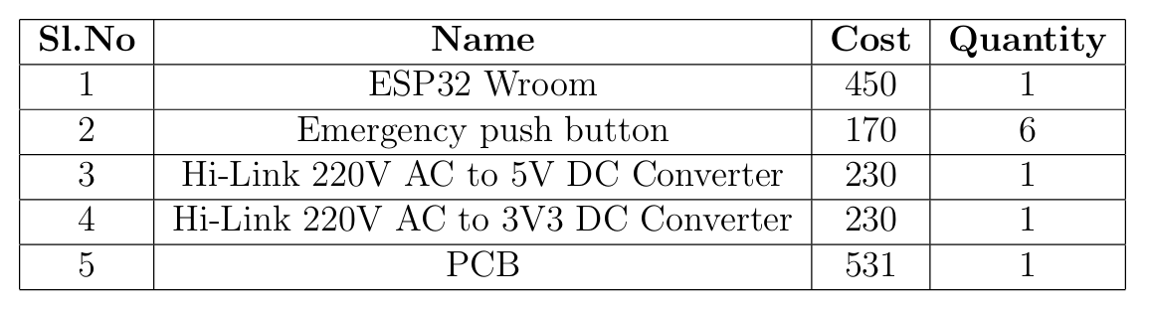
Bill of Materials:
School of Electronics and
Communication Engineering
Minor Project - 2024

Slide 9
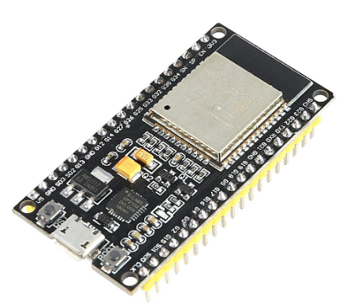

Hardware Details:
School of Electronics and
Communication Engineering
Minor Project - 2024

Slide 10
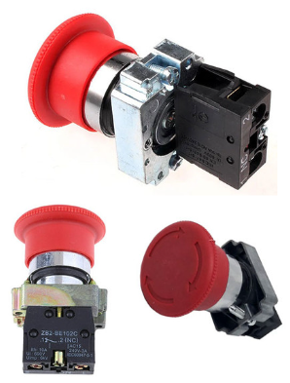
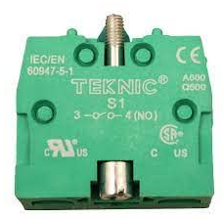
Hardware Details
School of Electronics and
Communication Engineering
Minor Project - 2024

Slide 11

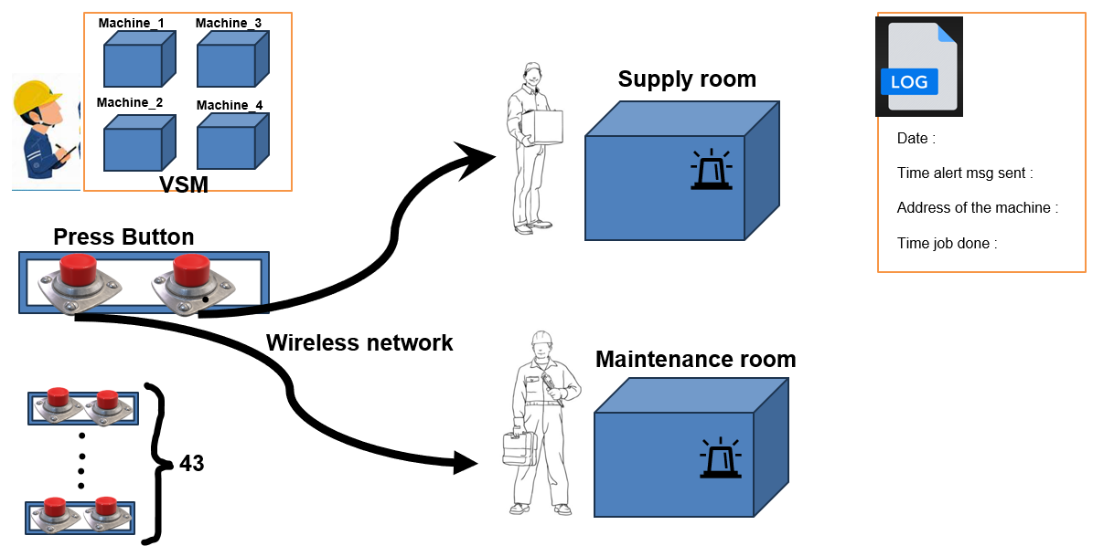
Methodology
Minor Project - 2024

Slide 12
Methodology
Introducing a cutting-edge solution for managing maintenance and supply chain issues within a network of plants housing various machines. Each machine is outfitted with a display unit signaling its operational status: green for normal functioning and red for issues. To address maintenance or supply chain problems and others , every machine is equipped with six buttons. Upon activation, these buttons wirelessly notify the designated personnel, facilitating prompt resolution of the identified issue.
Minor Project - 2024

Slide 13
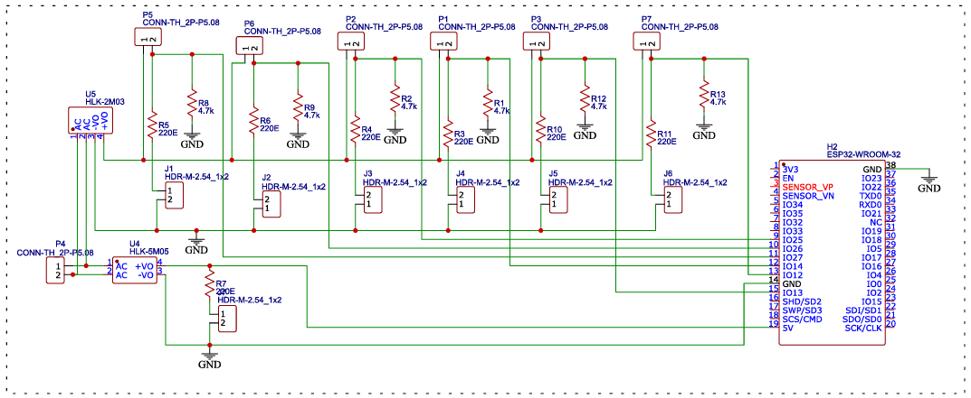
Schematic
Minor Project - 2024

Slide 14
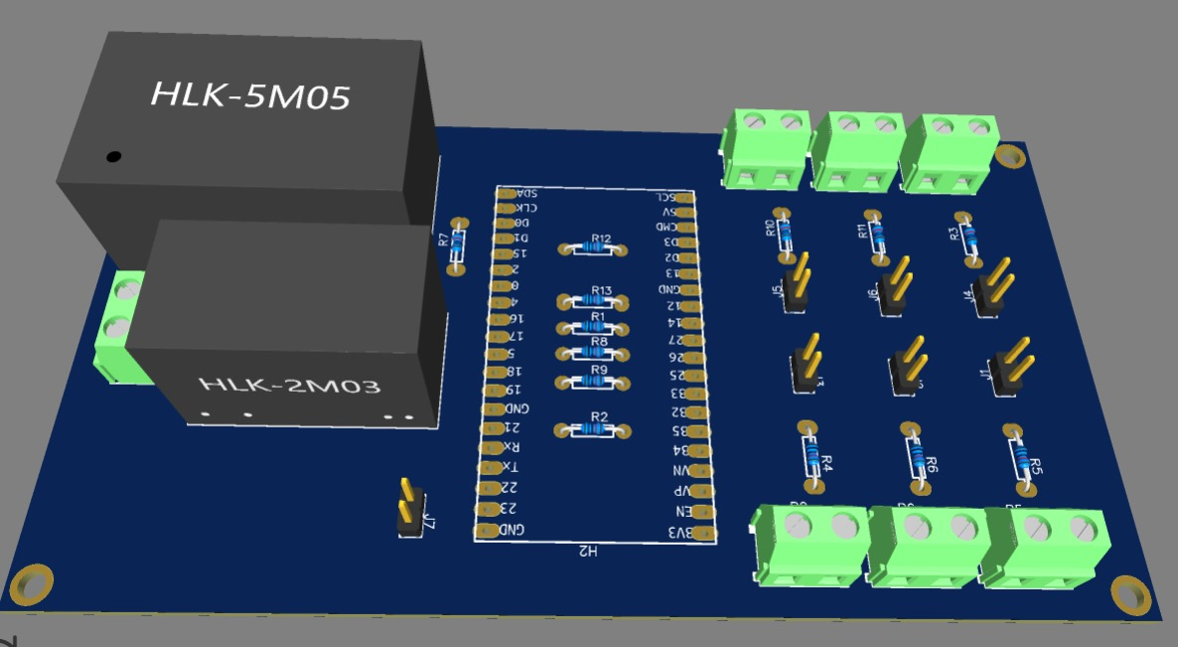
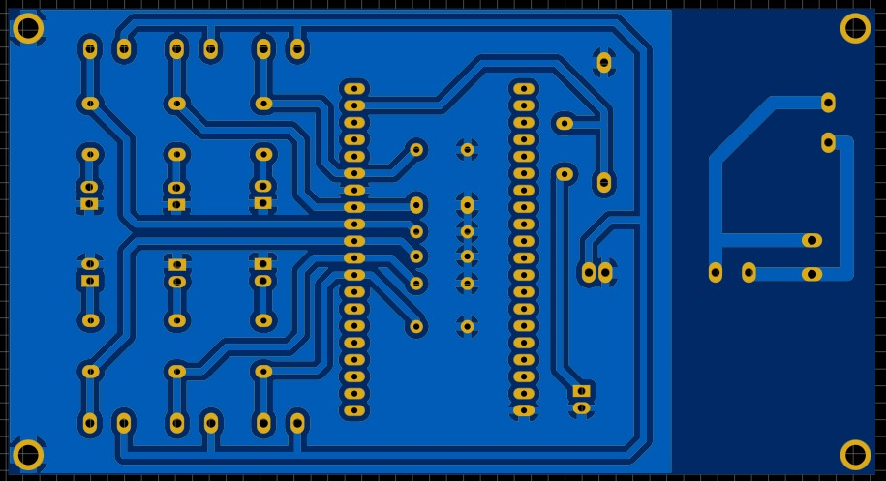
PCB Design
Minor Project - 2024

Slide 15
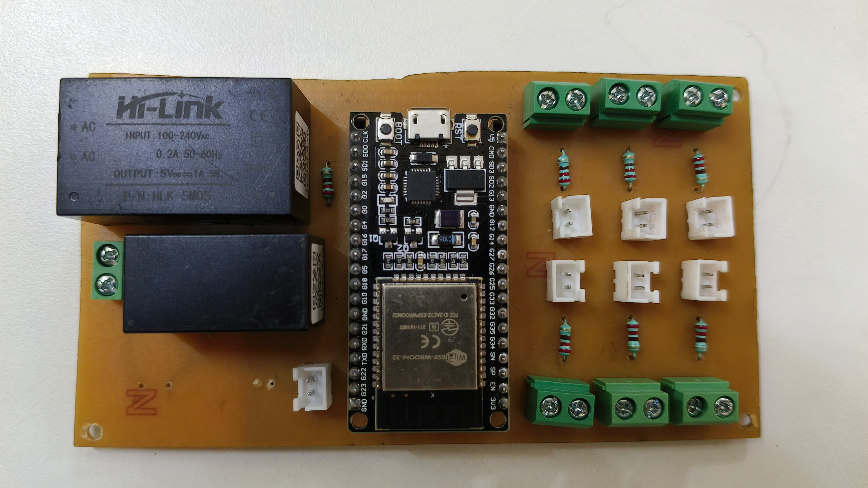
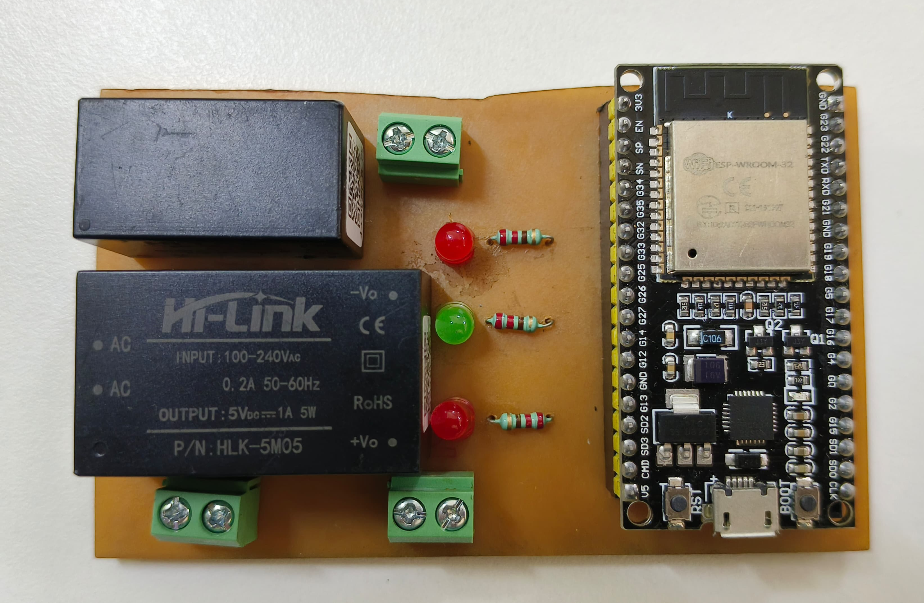
PCB Design
Minor Project - 2024

Slide 16
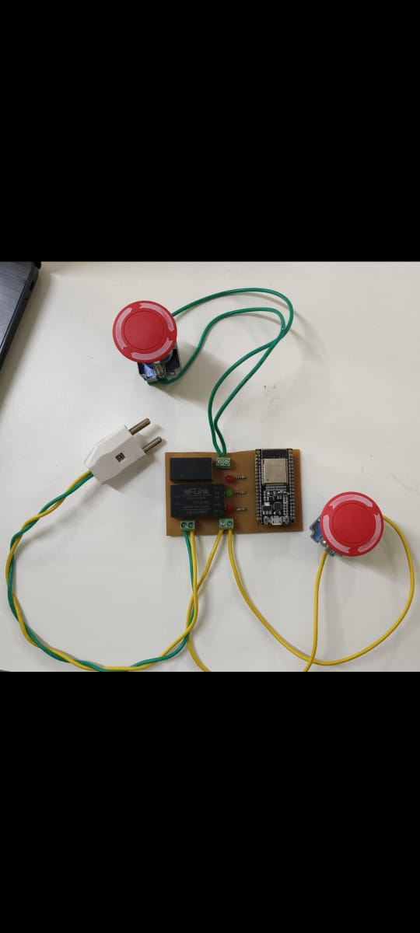
PCB Design
Minor Project - 2024

Slide 17

Alignment with SDG:
Minor Project - 2024

Slide 18
Alignment with SDG
• SDG 9: Industry, Innovation, and Infrastructure:-
This goal focuses on building resilient infrastructure, promoting inclusive and sustainable industrialization, and fostering innovation. Our project directly aligns with this goal by improving industrial infrastructure through monitoring and alert systems.
• SDG12: Responsible Consumption and Production:-
This goal aims to ensure sustainable consumption and production patterns. Our project contributes to this goal by optimizing equipment usage, reducing unnecessary downtime, and minimizing resource waste through timely maintenance alerts.
Minor Project - 2024

Slide 19
Alignment with SDG
• SDG 8: Decent Work and Economic Growth:-
Industrial equipment monitoring systems help create employment opportunities in the maintenance, repair, and supply chain management sectors. By improving the productivity and reliability of industrial processes, these systems contribute to economic growth and the creation of sustainable livelihoods.
Minor Project - 2024

Slide 20
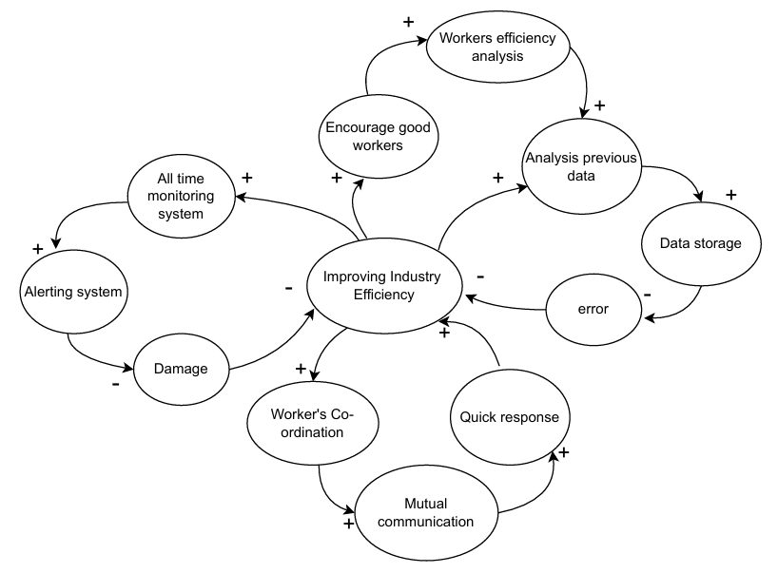
Causal Loop:
Minor Project - 2024

Slide 21
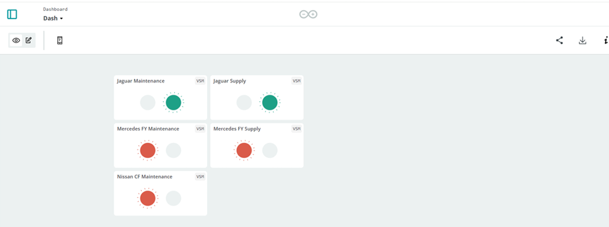
Implementation Results :
School of Electronics and
Communication Engineering
We have developed a comprehensive dashboard that provides real-time monitoring of the push button status in our wireless alerting system. This dashboard shown in Figure.
Minor Project - 2024

Slide 22
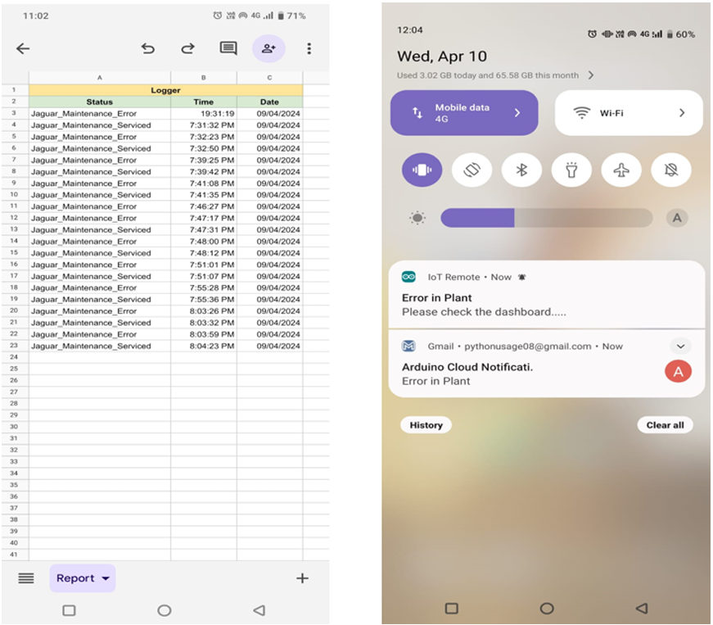
Implementation Results :
School of Electronics and
Communication Engineering
The Figure illustrates two critical components of our wireless alerting system:
The entries of alerts in Google Sheets and the notifications popping up on our mobile devices. These features enhance the system’s efficiency and ensure that alerts are promptly and accurately communicated to the relevant users.
Minor Project - 2024

Slide 23
Conclusion:
School of Electronics and
Communication Engineering
We are able to build a complete system which satisfies the industry needs. The project gave us lots of learnings and in-hand experience of working with the Industry. The product built is working well in the Industry environment and helps the workers to detect the need and efficiency of each machine placed in a plant. It also helps the manager to track service providers efficiency.
Minor Project - 2024

Slide 24
References:
School of Electronics and
Communication Engineering
PCB Design Course
Home Automation Project Example
Using Arduino IoT Cloud
Review of Hilink Converters
Industrial Push Buttons
Minor Project - 2024

Slide 25
School of Electronics and
Communication Engineering
THANK YOU
Minor Project - 2024

